Slide 1

Requirements in a long term agile project
Nick Draper
Tessella
www.mantidproject.org

Slide 2
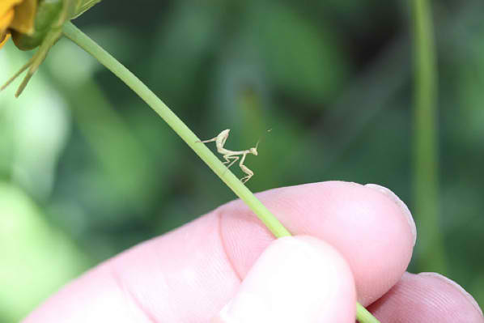
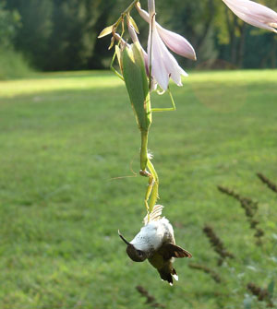
Overview
Requirements in Agile Projects
Requirements throughout Mantid
The problems
Our solution

Slide 3
Key Principles of Agile projects
Active user involvement is imperative
Requirements evolve but the timescale is fixed
Capture requirements at a high level; lightweight & visual
Develop small, incremental releases and iterate
Focus on frequent delivery of products
Apply the 80/20 rule
Testing is integrated throughout the project lifecycle – test early and often

Slide 4
Key Principles of Agile projects
Active user involvement is imperative
Requirements evolve but the timescale is fixed
Capture requirements at a high level; lightweight & visual
Develop small, incremental releases and iterate
Focus on frequent delivery of products
Apply the 80/20 rule
Testing is integrated throughout the project lifecycle – test early and often

Slide 5
Key Principles of Agile projects
Active user involvement is imperative
Requirements evolve but the timescale is fixed
Capture requirements at a high level; lightweight & visual
Develop small, incremental releases and iterate
Focus on frequent delivery of products
Apply the 80/20 rule
Testing is integrated throughout the project lifecycle – test early and often

Slide 6

Project Goals
Goals
Consolidate the data reduction/analysis software for neutron scattering without restricting the needs of the instrument scientists
Key requirement
Create a Data Analysis framework
not instrument or technique/dependent
Cross-platform
Windows, Linux, Mac
Easily extensible
Open source

Slide 7

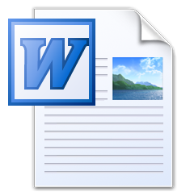
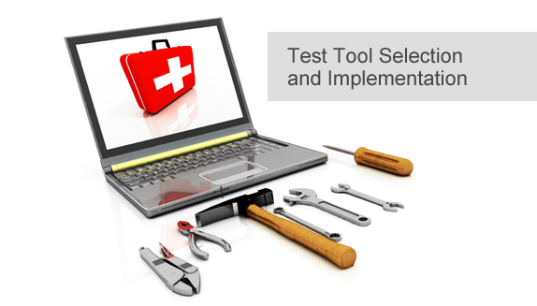
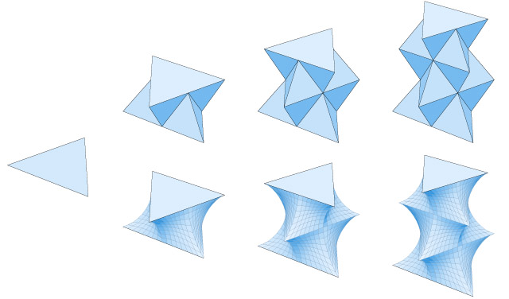
Mantid in the beginning
Requirements meetings
User Requirements Document
System Requirements Document
Architectural Design Document
Gaudi
In-house
Tool Selection
Prototyping & evaluation

Slide 8
Mantid in the beginning
Good
Bad
Wide cross section of scientists
Separated high level from details
Built relationships
Documented and agreed requirements
Learning from other projects
Evaluation of current software
Gathering best practice
Tough to separate vital detail from the rest
Stakeholder coverage
Accuracy vs. time
Bias
Requirements
Prototyping

Slide 9
Mantid early development
1 month iterations
Development
High risk design features
Plug in architecture
Python Integration
Vital common data structures
Workspace2D
Workspace History
Instrument Geometry
Common algorithms
LoadRaw
Rebin
ConvertUnits
Unit testing, continuous integration from the start
Evaluated by:
Lead Scientist
Project Manager
Project Team

Slide 10
Mantid early development
Good
Bad
Rapid development
De-risking design decisions
Validation of framework approach
Gathered momentum within the team
No wider stakeholder engagement
Little immediate use
Low visibility to senior management

Slide 11
Improving Stakeholder engagement
Scientific Steering Committee
1 -> 3 month releases
Better fit with cycle timings
User Training
Release Notes
Users
Scientific Steering Committee
Development Team
Project Management Board

Slide 12
Expanding the project
ISIS
SNS/HIFR
Scientific Steering Committee
Every 3 months
Local scientific steering committees
Joint teleconferences every 6 months
Two way information flow
Project progress -> scientsts
Requirements & priorities -> dev team
Users
Scientific Steering Committee
Development Team
Users
Scientific Steering Committee
Development Team
Project Management Board

Slide 13
Problems
The two facilities were in two very different situations
ISIS had been involved since the start, and were looking to extend capability.
SNS were finding how to fit Mantid to their needs
Information did not flow reliably beyond members
Progress
Requirements & Priorities
How to handle strategic and longer term tasks?
Requirements
Process
Visibility

Slide 14
Two timescales of requirements
Short term (Urgent)
Longer term (Planned)
Direct requests
Mantid-help email
Conversation with developers
Bugs or feature requests
Rapid response required
Larger features to sub-projects
Higher chance of standardization and reuse
Design
Planned implementation
Progress Reporting

Slide 15
Release Presentations
Just before each release
Everyone invited
But participation optional
Development team present progress
Different focus topic each time
Covers complete functionality in that area, not just improvements
Meet the team at the end
Opportunity to chat to the scientists and solve any problems.

Slide 16
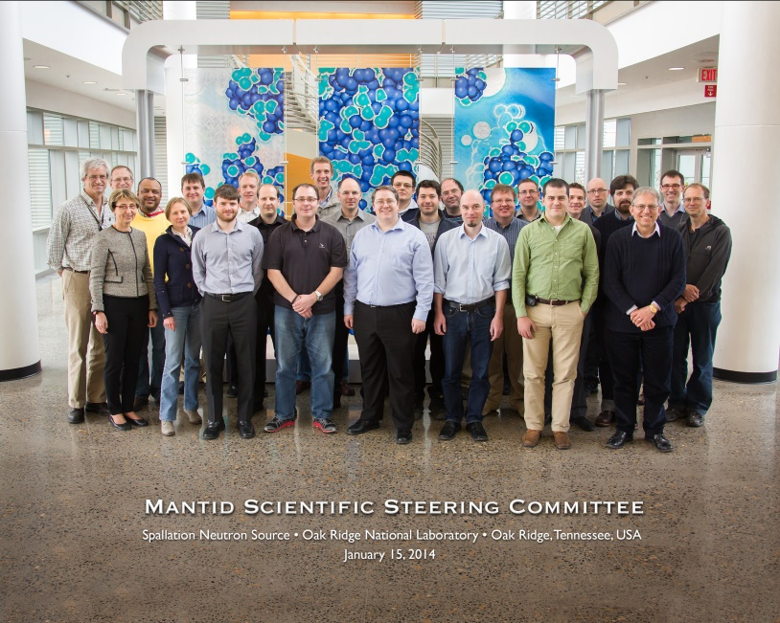
Annual Joint Scientific Steering Committee
Extract longer term requirements
Ask less often!
Place greater importance on the event
Spend time, listening and feeding back
Deliver on your promises
Encourage wider collaboration
Face to face meetings lead to much more agreement
The joint meeting allow time for other conversations with remote colleagues

Slide 17
Annual Joint Scientific Steering Committee
Annual meeting
Face to face
2 days
Venue rotates among member facilities
Feedback
During meeting
Development Roadmap
Release Notes
Sample Agenda
Day 1
Current status
Facility strategic goals
Science breakout groups
General & UI requirements
Day 2
Initial planning
Feedback and Discussion

Slide 18
Conclusion
A good overview at the start of an Agile project is essential
Requirements gathering approaches need to change during a long term project
Do not assume that others will pass the message of the good work you are doing onwards
One collaborative project is a great opportunity to found others

Slide 19

Project History
July 2007 Requirements & Design
April 2008 V 1.0 First instrument support
Feb 2010 V1.1 Support multiple techniques
April 2010 Collaboration with SNS & HFIR
Jan 2012 V2.0
Scientist validated results. VATES integration

